Slide 1
Practice Day 1

Slide 2
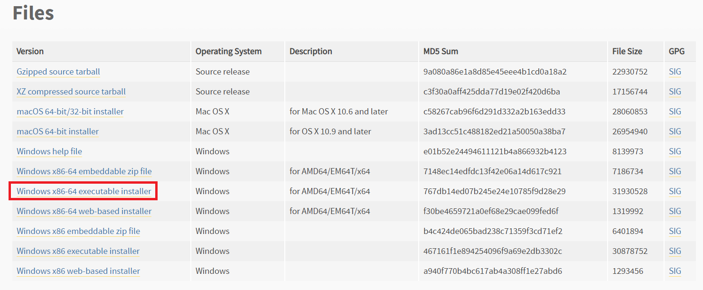
Install Python
Python 3.6.6
https://www.python.org/downloads/release/python-366/
Download Windows x86-64 executable installer and install it.

Slide 3
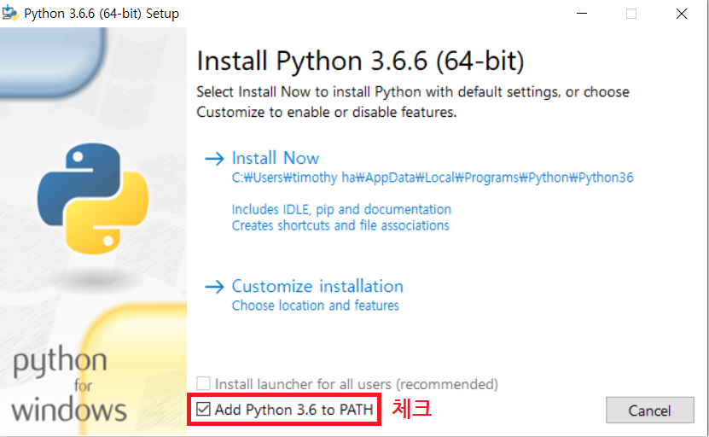
Install Python
Python 3.6.6
Add Python 3.6 to Environment Variable Path

Slide 4
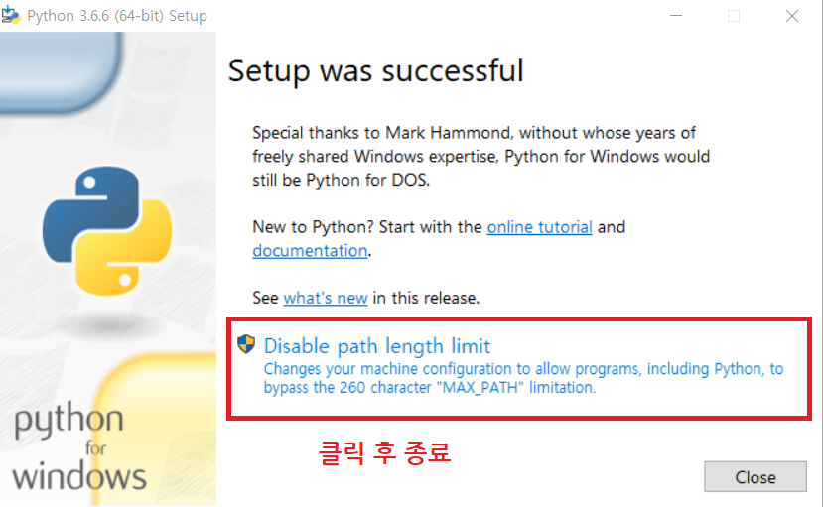
Install Python
Python 3.6.6
설치 후

Slide 5
Other Installations
cmd 창 열기
Windows 검색 -> cmd (명령 프롬프트) -> 관리자 권한으로 실행
cmd 창에서 명령어 입력
pip3 install tensorflow
pip3 install jupyter
pip3 install matplotlib
설치 확인
cmd 창
py
import tensorflow
Import matplotlib
exit()

Slide 6
Other Installations
Git 설치
https://git-scm.com/download/win
Download 64-bit version Git
Install Git
실습파일 download
cmd 창
cd c:\Users\<User name>\Documents
git clone https://github.com/rllab-snu/Day-1-Regression.git
Jupyter notebook 실행
cmd 창
cd c:\Users\<User name>\Documents
jupyter notebook

Slide 7
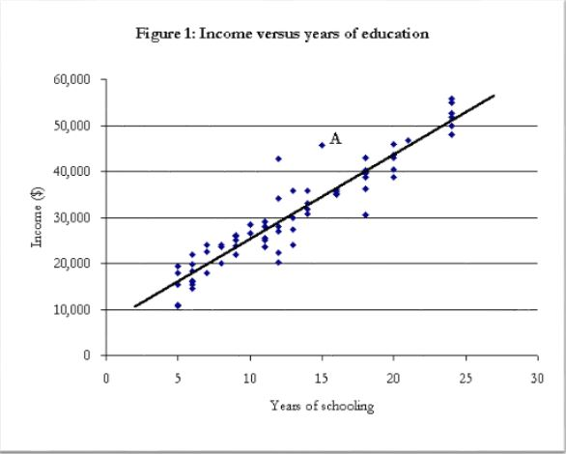
Regression
주어진 데이터가 있을 때 변수들 간의 인과 관계를 찾는 것
Ex) “Year of schooling” vs “Income”

Slide 8
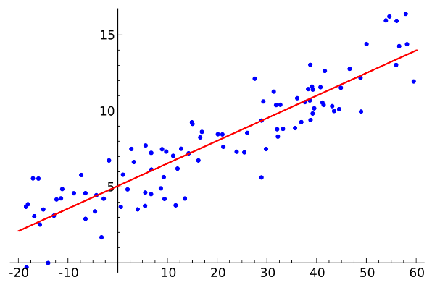
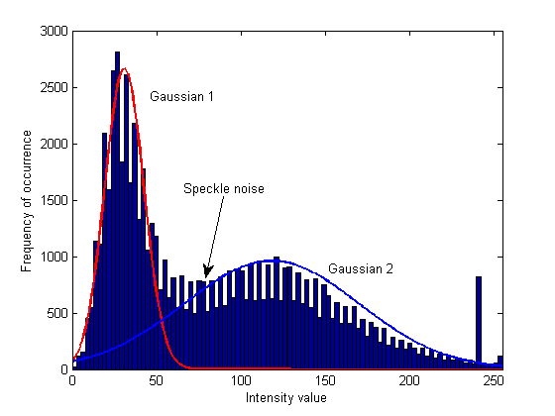
Regression
종류
Linear Regression
Gaussian Mixture Model
Kernel Regression
Gaussian Process Regression
Etc…

Slide 9
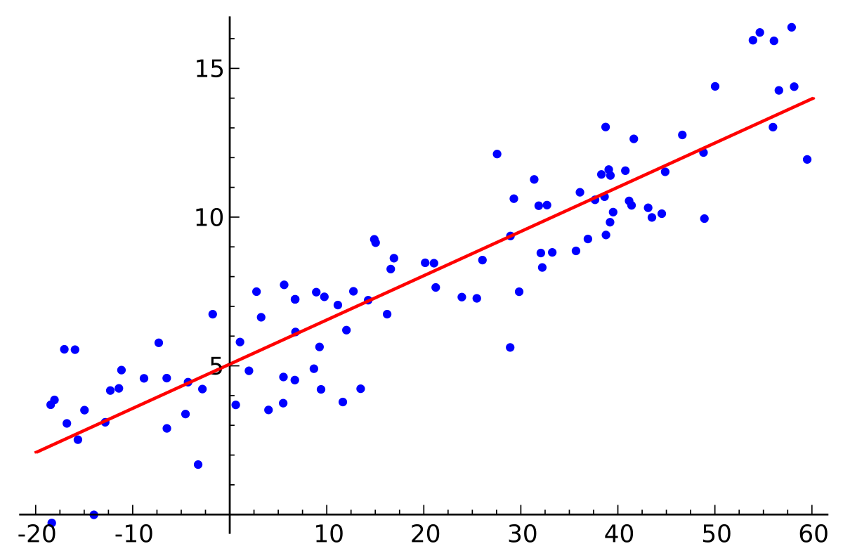


Linear Regression
Data : ${\{\left(x_{i},y_{i}\right)\}}_{i=1,…,N}$
Linear Regression
$y=w_{1}x+w_{0}$
Goal
Fine $w_{1},w_{o}$ that best fits the data
Minimize loss
$loss=$

Slide 10
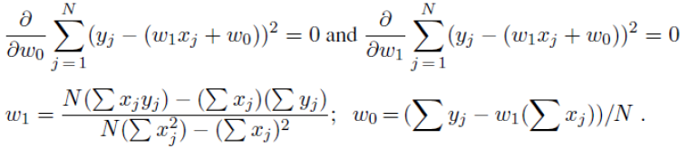

Linear Regression
Closed Form solution
$$loss=$$
Get derivative

Slide 11
Practice
Learn Python and Tensorflow
File I/O
numpy
tensorflow
Linear Regression
Closed form solution
Gradient descent

Slide 12
Tensorflow
Build a graph
Tensor
Initial variables
Placeholder
Loss
Optimizer
Variable initializer
Etc…
Open tf.Session
sess = tf.Session()
sess.run()
Anything defined in the graph
sess.run(something, feed_dict={placeholder : my_data})

Slide 13


